Slide 1


Noida Institute of Engineering and Technology, Greater Noida
Introduction to Project
Unit: I
Project Management
AOE0761
Harshit Thakur
Assistant Professor
CSE
B.Tech VII Semester

Slide 2
Index
S. No. | Content
1. | Name of Subject with code, Course and Subject Teacher
2. | Brief Introduction of Faculty member with Photograph
3. | Evaluation Scheme
4. | Syllabus
5. | Branch wise Application
6. | Course Objective(s)
7. | Course Outcome(s)
8. | Program Outcomes (PSOs)
9. | Cos and POs Mapping

Slide 3
Index
S. No. | Content
10. | Program Specific Outcomes (PSOs)
11. | Cos and PSOs Mapping
12. | Program Educational Objectives (PEOs)
13. | Result Analysis
14. | End Semester Question paper Templates
15. | Prequisite/Recap
16. | Brief Indtroduction about the Subject with Videos
17. | Unit Contents
18. | Unit Objectives
19. | Topic Objectives/Topic Outcome

Slide 4
Index
S. No. | Content
20. | Lecture related to topic
21. | Daily Quiz
22. | Weekly Assignment
23. | Topic Links
24. | MCQs
25. | Glossary Questions
26. | Old question papers
27. | Expected Questions
28. | Recap of unit

Slide 5
Faculty Profile
Faculty Name: Harshit Thakur
Designation: Assistant Professor
Department: CSE
Email ID: harshit.thakur@niet.co.in
Qualification: M.Tech, B.Tech
Specialisation: CSE
Research Area: Cloud Computing
Total Experience: 1 Year

Slide 6
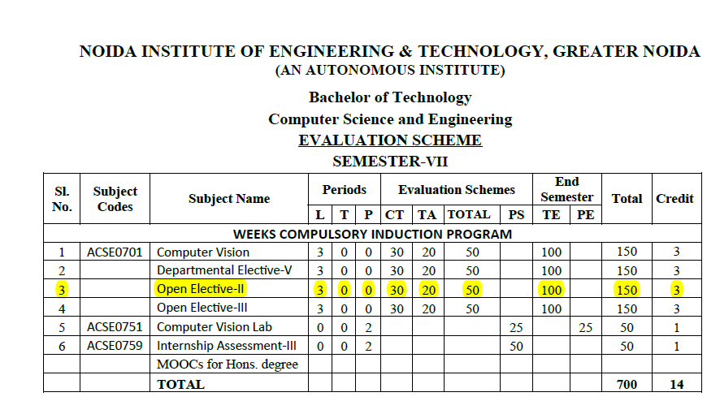
Evaluation Scheme

Slide 7
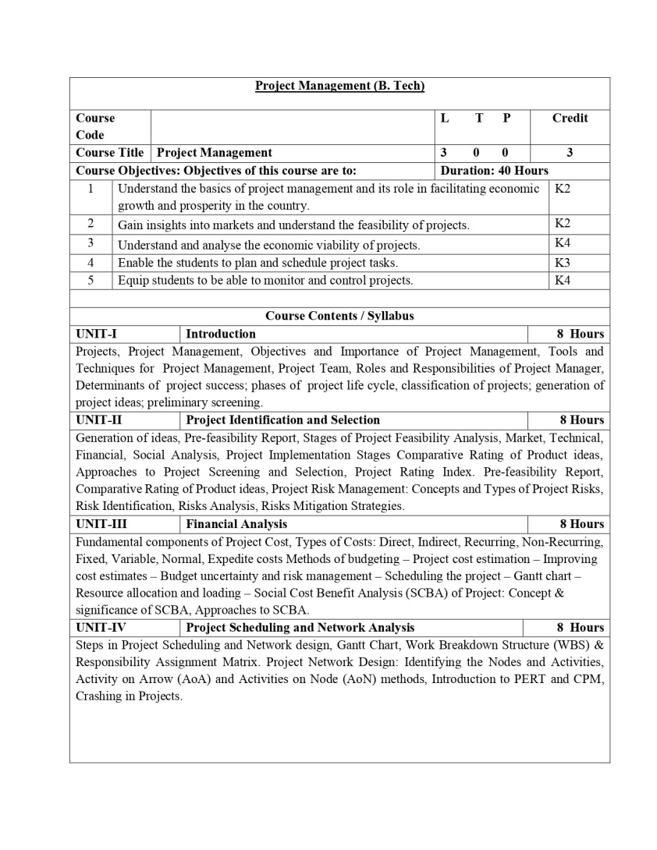
Syllabus

Slide 8
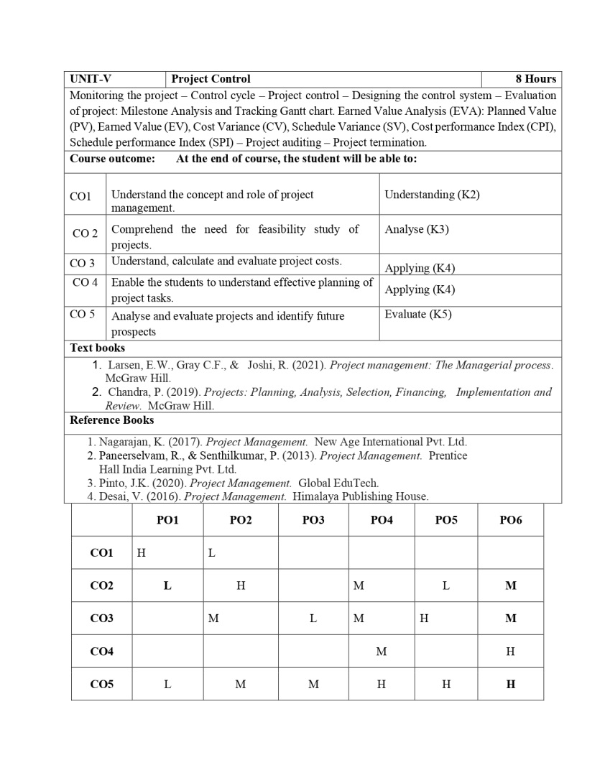
Syllabus

Slide 9
Branch Wise Application
Handling projects.
Evaluating & Monitoring Project Process
Taking necessary and corrective action.

Slide 10
Course Objectives
To empower the students to get insights of basic concepts on project management.
To create awareness on the roles and responsibilities of project manager.
To build the confident among the students to take up any kind of projects.
To sharpen the planning, scheduling and controlling skills of the students with respect to individual projects.
To understand the perspectives in which optimum decisions are to be taken in case of risks with planned activities in project.

Slide 11
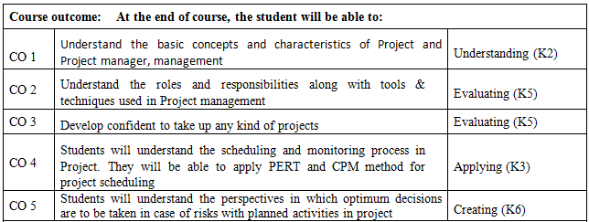
Course Outcome

Slide 12
Program Outcomes
1. Apply knowledge of management theories and practices to solve business problems.
2. Foster analytical and critical thinking abilities for data-based decision making.
3. Ability to develop value based leadership ability.
4. Ability to understand, analyze and communicate global, economic, legal and ethical aspects of business.
5. Ability to lead themselves and others in the achievement of organizational goals, contributing effectively to a team environment.

Slide 13
CO-PO and PSO Mapping
S No | CO/PO | PO1 | PO2 | PO3 | PO4 | PO5 | PO6
1 | CO1 |  | 3 |  | 2
2 | CO2 |  |  | 3 |  |  | 2
3 | CO3 |  | 3
4 | CO4 |  |  | 1 |  | 3
5 | CO 5 | 1 | 2
*1=High, *2=Medium, *3=Low
Program Specific Outcomes | Course Outcomes
 | 1 | 2 | 3 | 4 | 5
1 |  | 3 |  | 1
2 | 1 |  | 1 |  | 2
3 | 1 |  | 2

Slide 14
Program Educational Objective
PEO 1: Graduates of the Management program will have conceptual knowledge, to adapt to the rapidly changing environment, learn new skills and demonstrate application of management principles in a professional work setting.
PEO 2: Graduates will apply appropriate tools for decision making required for solving complex managerial problems in the local or global context.
PEO 3: Graduates of the Management program will exhibit integrity, social responsibility and teamwork.
PEO 4: Graduates will exhibit ethics, communication skills, leadership qualities and entrepreneurial mindset using creativity and innovation.

Slide 15
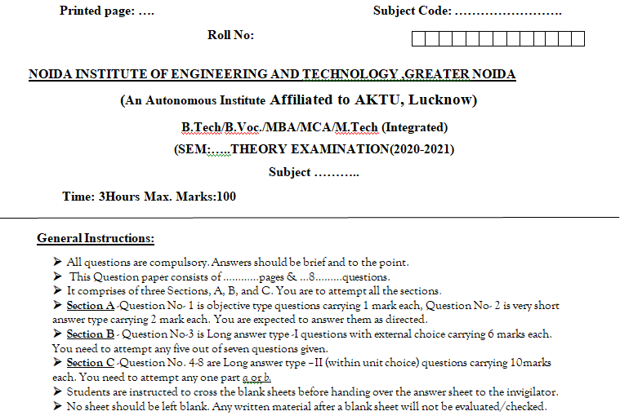
End Semester Question Paper Template

Slide 16
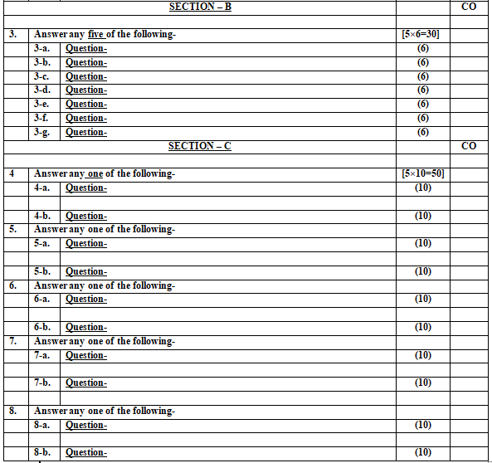
End Semester Question Paper Template

Slide 17
Objective of Unit
Objective of this unit are:
To make the students learn about project and project management.
To make to students understand the project management process.
To make the students know about the project life cycle.

Slide 18
Content of Unit
Unit-1:
Projects, Project Management, Objectives and Importance of Project Management, Tools and Techniques for Project Management, Project Team, Roles and Responsibilities of Project Manager, Determinants of project success; phases of project life cycle, classification of projects; generation of project ideas; preliminary screening.

Slide 19
Prerequisites and Topic wise Recap
Prerequisites for this session are:
General understanding of management.
General understanding of business environment.
Recap:
Introduction to course KMB 401, syllabus, evaluation scheme.

Slide 20
Topic & CO Mapping
S No | Topic | CO | Level
1 | Definitions & Characteristics of Project | CO 1 | 1
2 | Types of Projects | CO 1 | 1
3 | Project Life Cycle | CO 1 | 1
4 | Determinants of project success; phases of project life cycle, classification of projects; generation of project ideas; preliminary screening. | CO 1 | 2

Slide 21
Session/ Topic Objectives
To understand Definitions & Characteristics of Project,
To learn about Types of Projects,
To understand the Project Life Cycle.
To understand the generation of project ideas.

Slide 22
Project
It’s a temporary group activity designed to produce a unique product, service or result.
(PMI, USA)

Slide 23
Project
A project is temporary- It has a defined beginning and end in time, and therefore defined scope and resources.
A project is unique- It is not a routine operation, but a specific set of operations designed to accomplish a singular goal. So a project team often includes people who don’t usually work together – sometimes from different organizations and across multiple geographies.

Slide 24
Project Management
Application of knowledge, skills and techniques to execute projects effectively and efficiently.
It’s a strategic competency for organizations, enabling them to tie project results to business goals and thus, better compete in their markets.

Slide 25
Characteristics of Project
Projects have defined objectives
Projects have defined life span with a beginning & an end
Projects usually involve several departments & professionals
Projects typically haven’t been done before
Projects have specific time, cost & performance requirements

Slide 26
Importance of Project Management
Clearly defines the plan of the project before it begins
Establishes an agreed schedule and plan
Creates a base for teamwork
Resources are maximized
Helps to manage integration
Helps to keep control of costs
Helps to manage change
Quality is continuously managed
Creates an opportunity for learning

Slide 27
Objectives of Project Management
Project management involves a set of activities aimed at achieving specific goals within defined constraints such as time, cost, and resources. Here are the primary objectives of project management:
1. Scope Management:
- Clearly define the project’s goals and deliverables.
- Ensure all stakeholders have a shared understanding of the project scope.
- Manage changes to the project scope to prevent scope creep.
2. Time Management:
- Develop a detailed project schedule outlining all tasks and milestones.
- Allocate time effectively to ensure project deadlines are met.
- Monitor progress and adjust schedules as necessary to stay on track.
3. Cost Management:
- Estimate project costs accurately to create a realistic budget.
- Monitor and control spending to keep the project within budget.
- Implement cost-saving measures without compromising project quality.
4. Quality Management:
- Set quality standards for project deliverables.
- Implement processes to ensure deliverables meet these standards.
- Continuously improve processes and outputs to enhance quality.

Slide 28
Objectives of Project Management
5. Resource Management:
- Identify and allocate necessary resources, including human resources, materials, and equipment.
- Optimize the use of resources to prevent bottlenecks and maximize efficiency.
- Resolve resource conflicts and ensure resources are used effectively.
6. Risk Management
- Identify potential risks that could impact the project.
- Develop mitigation strategies to reduce the likelihood and impact of risks.
- Monitor and manage risks throughout the project lifecycle.
7. Communication Management
- Develop a communication plan to keep all stakeholders informed.
- Ensure effective communication channels are in place for timely updates and feedback.
- Foster collaboration and resolve any communication issues promptly.

Slide 29
Objectives of Project Management
8. Stakeholder Management:
- Identify all project stakeholders and understand their needs and expectations.
- Engage stakeholders throughout the project to ensure their input and buy-in.
- Manage stakeholder expectations and address their concerns.
9. Integration Management:
- Ensure all project elements are coordinated and work together seamlessly.
- Manage interdependencies between different project activities.
- Ensure that project goals align with organizational objectives.
10. Procurement Management:
- Plan and manage procurement processes for acquiring necessary goods and services.
- Select vendors and manage contracts to ensure timely delivery of quality products/services.
- Monitor procurement activities and manage supplier relationships.

Slide 30
Tools & Techniques of Project Management
Program Evaluation Review Technique (PERT)
Gantt Charts
Work Breakdown Structure (WBS)
Cost Breakdown Structure (CBS)

Slide 31
Steps in Drawing Gantt Chart
5. Presenting the analysis.
In the final version of Gantt chart, combine draft analysis (Step 3) with scheduling and analysis of resources (Step 4).

Slide 32
Work Breakdown Structure
WBS produces a detailed list of tasks to be performed for a project, helping to deliver a better costing, scheduling and resource planning for a project.
Purpose of WBS is to help plan effectively for a project by breaking key tasks & activities down into more manageable & smaller units of works.

Slide 33
Cost Breakdown Structure
CBS lists every item classified and its expenditure for the project in order to get more detailed estimates of cost or expenditure

Slide 34
How WBS or CBS helps in budgeting
Staff hours for each task or activity assigned x Staff hourly rates per hour
Staff hours for each task or activity assigned x Overhead rates per hour
Equipment, financing or resources more accurately planned for given more detail of the task to undertake.

Slide 35
Benefits of using WBS
To allocate & delegate responsibility to help accomplish different tasks or activities.
Sequencing & scheduling the time of different events to improve effectiveness of how time is allocated
Improves resource planning & efficiency of how resources are consumed
Used as a basis for financial exception reporting

Slide 36
PROJECT TEAM
A project team is a group of individuals assembled to work collectively on achieving specific project goals. The team is typically composed of members with various skills and expertise relevant to the project's objectives.

Slide 37
Characteristics of a Project Team
Clearly defined goals
Clearly defined roles
Open and clear communication
Effective decision making
Balanced participation
Valued diversity
Managed conflict
Positive atmosphere
Cooperative relationships
Participative leadership

Slide 38
Characteristics of a Project Leader
Inspires a shared vision
Good Communicator
Integrity
Enthusiasm
Empathy
Competence
Ability to delegate tasks
Cool under pressure
Team building Skills
Problem Solving Skills

Slide 39
PROJECT MANAGER
The term “project manager” is so broad that it can encompass various tasks and mean different things to different people. So what is the typical job description for a project manager? A project manager is responsible for overseeing a project from start to finish. The responsibilities of a project manager include:
Planning the project
Creating a schedule and timeline
Executing each phase
Managing the budget
Serving as the liaison among all stakeholders
Troubleshooting and maintenance
Project managers must be highly organized, detail-oriented, and possess excellent people skills — after all, they are responsible for leading the team and communicating clearly and regularly with all relevant parties.

Slide 40
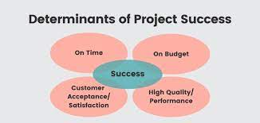
Determinants of Project Success

Slide 41
Determinants of Project Success
The success of a project is influenced by various determinants that ensure it meets its objectives within the set constraints. Here are the key determinants of project success:
1. Clear Objectives and Goals:
- Defined Scope:Clearly articulated project scope with specific, measurable, achievable, relevant, and time-bound (SMART) goals.
- Alignment: Project goals should align with organizational objectives and stakeholder expectations.
2. Effective Planning:
- Comprehensive Plan:Detailed project plan outlining tasks, milestones, timelines, resources, and dependencies.
- Contingency Planning: Identification of potential risks and development of mitigation strategies.
3. Strong Leadership:
- Project Manager Competence: Skilled project manager with the ability to lead, motivate, and manage the team effectively.
- Decision-Making:Prompt and informed decision-making capabilities.

Slide 42
Determinants of Project Success
4. Team Competence and Cohesion:
- Skills and Expertise: Team members with the required skills and expertise relevant to the project.
- Collaboration: Effective teamwork, communication, and collaboration among team members.
5. Resource Management:
- Adequate Resources: Availability of necessary resources (financial, human, material) to complete the project.
- Efficient Utilization: Optimal use of resources to avoid wastage and maximize productivity.
6. Stakeholder Engagement:
- Communication: Regular and transparent communication with all stakeholders to keep them informed and engaged.
- Involvement: Active involvement of stakeholders in key decisions and project milestones.

Slide 43
Determinants of Project Success
7. Risk Management:
- Risk Identification: Early identification of potential risks and uncertainties.
- Mitigation Strategies: Development and implementation of strategies to mitigate identified risks.
8. Quality Management:
- Standards and Metrics: Establishment of quality standards and metrics to measure project deliverables.
- Continuous Improvement: Ongoing efforts to improve processes and outputs to meet or exceed quality expectations.
9. Timely and Accurate Reporting:
- Progress Tracking: Regular tracking of project progress against the plan.
- Issue Resolution: Prompt identification and resolution of issues and bottlenecks.
10. Adaptability and Flexibility:
- Change Management: Effective management of changes in project scope, schedule, and resources.
- Adaptability: Ability to adapt to unforeseen circumstances and adjust plans accordingly.

Slide 44
Determinants of Project Success
10. Adaptability and Flexibility:
- Change Management: Effective management of changes in project scope, schedule, and resources.
- Adaptability: Ability to adapt to unforeseen circumstances and adjust plans accordingly.
11. Customer Satisfaction:
- Requirements Fulfillment: Deliverables that meet or exceed customer requirements and expectations.
- Feedback Mechanism: Mechanism for obtaining and incorporating customer feedback.
12. Post-Implementation Review:
- Lessons Learned: Conducting a review after project completion to identify lessons learned.
- Continuous Improvement: Applying insights gained to improve future project performance.

Slide 45
Project Life Cycle
Series of activities which are necessary to fulfill goals or objectives.
Recognizes that projects have limited life span.
Recognizes that there are predictable changes in level of effort & focus over the life of project.

Slide 46
Project Life Cycle
Defining
Planning
Executing
Delivering
Level of Effort
Goals
Specifications
Tasks
Responsibilities
Schedules
Budgets
Resources
Risks
Staffing
Status Report
Changes
Quality
Forecasts
Train Customer
Transfer Documents
Release Resources
Reassign Staff
Lessons Learned

Slide 47
1. The Defining Stage
Specifications of the project are defined, project objectives are established, teams are formed, and major responsibilities are assigned.

Slide 48
2. The Planning Stage
Level of effort increase & plans are developed that answer such questions as:
What?
When?
Who?
Quality?
Budgets?

Slide 49
3. The Executing Stage
Major portion of project takes place- both physical & mental- physical product is produced.
Time, cost & specifications measures are used for control.

Slide 50
4. The Delivering Stage
Usually include two activities:
Delivering the completed project to customer
Redeploying the project Resources
Delivery of project might include customer training & transferring documents

Slide 51
Classification of Projects
Construction or Engineering Projects
Experimental/Research/Measurement Projects
Search and Find Projects
Earth Sciences Projects
Life Science Projects
Physical Science Projects

Slide 52
Business Projects
Anything that move the business strategy in a forward direction.
This can include something as basic as establishing a location for a certain business process, or scheduling production or schedules related to business processes.

Slide 53
Developmental Projects
They are usually a big part of researching and developing a new aspect of business.
This can involve the development of a new product or trying to migrate an existing product into new markets.

Slide 54
Technical Projects
These are among the most complex in any business environment and are usually closely married to Information Technology (IT) processes.

Slide 55
On the Basis of Tenure
Small Projects (1-3 weeks)
Medium Projects (3-6 weeks)
Large Projects (6-12 weeks)
Super Projects (13 weeks or more)

Slide 56
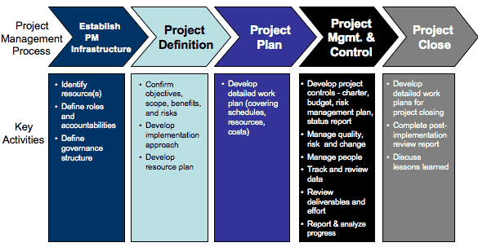
Project Management Process

Slide 57
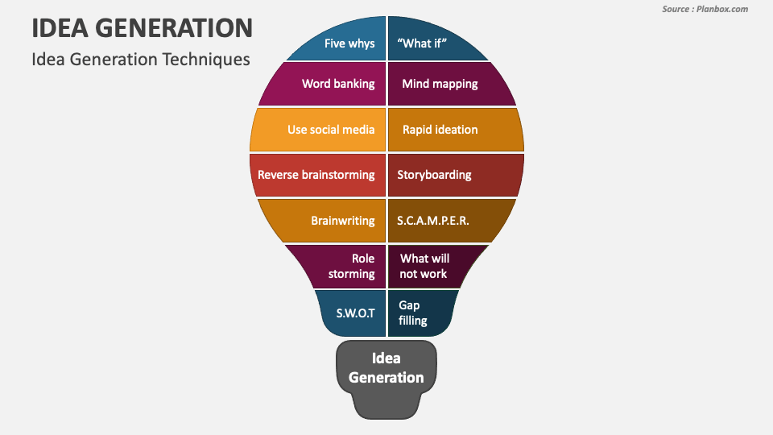
Idea Generation

Slide 58
Generation of Project ideas
Generating project ideas is a crucial initial step in the project management process. It involves identifying viable project opportunities that can address specific needs, solve problems, or take advantage of new opportunities. Here are several methods and approaches for generating project ideas:
1. Brainstorming Sessions:
- Gather a diverse group of stakeholders to discuss and generate a wide range of ideas.
- Encourage free thinking and open dialogue to foster creativity.
2. SWOT Analysis:
- Conduct a SWOT analysis (Strengths, Weaknesses, Opportunities, Threats) to identify areas where projects can leverage strengths, address weaknesses, capitalize on opportunities, or mitigate threats.

Slide 59
Generation of Project ideas
3. Market Research:
- Analyze market trends, customer needs, and industry developments to identify gaps and opportunities for new projects.
- Conduct surveys, focus groups, and interviews to gather insights from potential users or customers.
4. Benchmarking:
- Study successful projects and best practices within the industry or in other sectors to inspire new ideas.
- Analyze competitors’ projects to identify areas for improvement or differentiation.
5. Internal Analysis:
- Review internal processes, performance metrics, and feedback to identify inefficiencies or areas for improvement that could be addressed through new projects.
- Engage employees across various departments to solicit ideas based on their experiences and expertise.

Slide 60
Generation of Project ideas
6. Customer Feedback:
- Collect feedback from customers through surveys, interviews, or support channels to understand their needs, pain points, and suggestions.
- Analyze customer complaints and suggestions to identify recurring issues that could be solved with a new project.
7. Trend Analysis:
- Monitor industry trends, technological advancements, and societal changes to identify emerging opportunities for innovative projects.
- Attend industry conferences, webinars, and trade shows to stay updated on the latest trends and ideas.
8. Strategic Alignment:
- Align project ideas with the organization’s strategic goals and objectives to ensure relevance and support from senior management.
- Review the organization’s mission, vision, and long-term plans to identify project opportunities that contribute to strategic priorities.

Slide 61
Generation of Project ideas
9. Innovation Workshops:
- Conduct workshops focused on creative problem-solving and innovation to generate novel project ideas.
- Use techniques like design thinking, mind mapping, and the SCAMPER method (Substitute, Combine, Adapt, Modify, Put to another use, Eliminate, and Reverse) to stimulate innovative thinking.
10. Partnerships and Collaborations:
- Collaborate with other organizations, research institutions, or industry experts to co-create project ideas.
- Explore joint ventures, partnerships, and alliances to leverage complementary strengths and resources.
11. Feasibility Studies:
- Conduct preliminary feasibility studies to evaluate the potential of different ideas based on factors like cost, time, resources, and expected benefits.
- Prioritize ideas that are both feasible and aligned with organizational goals.

Slide 62
Generation of Project ideas
12. Employee Suggestion Programs:
- Establish formal programs to encourage employees to submit project ideas, providing incentives or recognition for valuable contributions.
- Create an accessible platform where employees can share and discuss their ideas.
13. Reverse Engineering:
- Analyze successful projects or products to understand their core components and identify potential improvements or new applications.
- Deconstruct existing solutions to find inspiration for new projects.

Slide 63
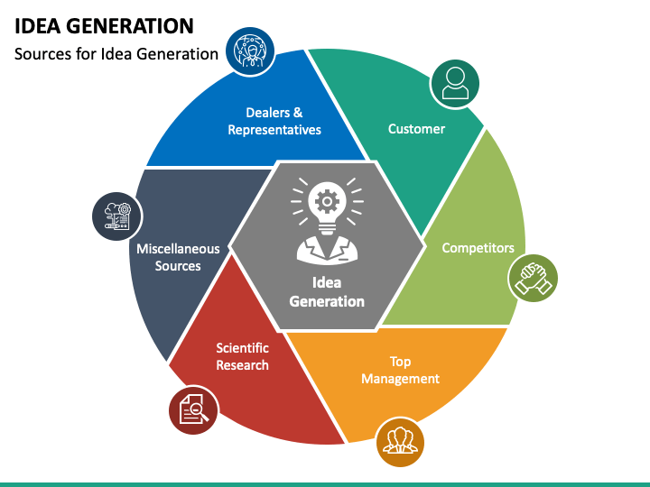
Sources of Idea Generation

Slide 64
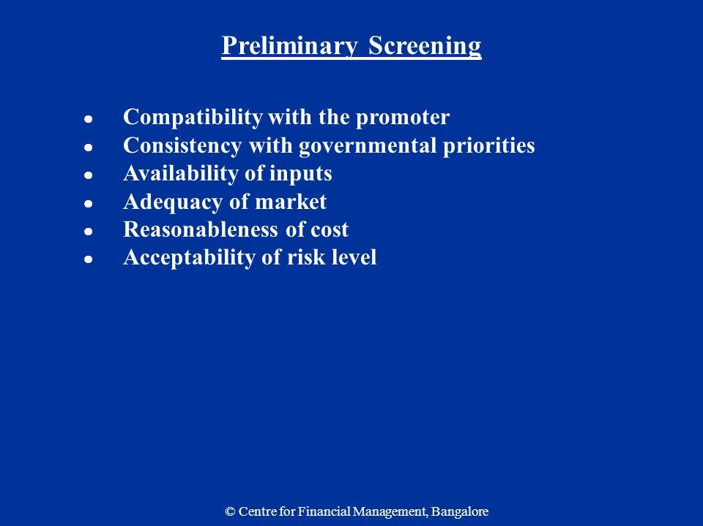
Preliminary Screening

Slide 65
Summary
The Project Organization defines the human infrastructure of the project.
This task is designed to define the project organization chart, the roles, and the relationships of the project team.
Matrix project is not separated from parent organizations.
Coordination between project team and project manager brings synergy in process.

Slide 66
Youtube Links
https://www.youtube.com/watch?v=BOU1YP5NZVA
https://www.youtube.com/watch?v=ZKOL-rZ79gs
https://www.youtube.com/watch?v=RjOA7AxOVj8&list=PLPjSqITyvDeX77O9g4E_lgJbAmLK5SFu6

Slide 67
Daily Quiz
Q1. Discuss the importance of project management.
Q2. Describe the project.
Q3. Discuss the characteristics of project team.
Q4. Elaborate the matrix organization.
Q5. Discuss the staff organization.
Q6. Explain the WBS
Q7. Explain the cost breakdown structure.

Slide 68
Weekly Assignment
Q1. Define the project and project management. Also discuss the Characteristics of a project.
Q2. Discuss the types of projects.
Q3. Describe the project management cycle.
Q4. Describe various tools and techniques of project management.

Slide 69
MCQ s
Which of the following is not a project management goal?
Keeping overall costs within budget
Delivering the software to the customer at the agreed time
Maintaining a happy and well-functioning development team
All of the above
2. The process each manager follows during the life cycle of a project is known as
Project Management
Manager life cycle
Project Management Life Cycle
All of the mentioned

Slide 70
MCQ s
3. Quality planning is the process of developing a quality plan applicable for.
Team
Project
Customers
project manager
4. Which of the following is an incorrect activity for the configuration management of a software system? A. Internship management B. Change management C. Version management D. System management

Slide 71
MCQ s
5. Gantt chart was invented by
Frank Gantt
Henry Gantt
Duke Gantt
Bill Gantt
6. The business idea must be compatible with the following attributes of entrepreneur.
Interest
Personality
Resources
All of the above

Slide 72
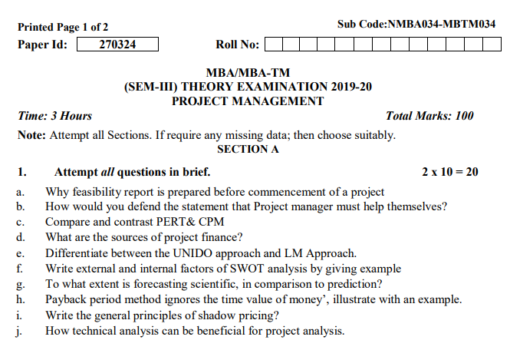
Old Question Papers

Slide 73
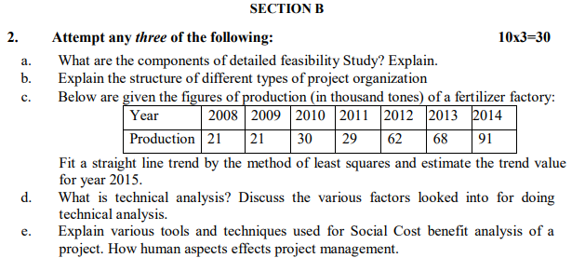
Old Question Papers

Slide 74
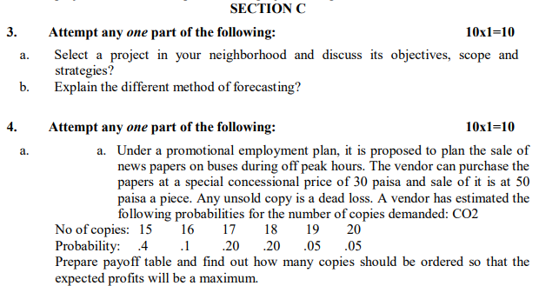
Old Question Papers

Slide 75
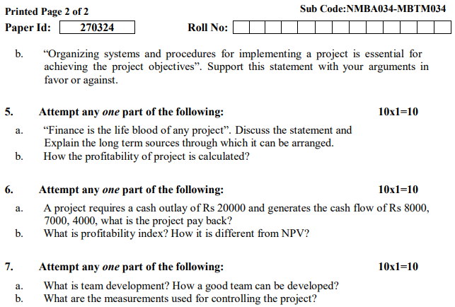
Old Question Papers

Slide 76
Expected Questions for University Exam
Q1. Discuss the project. elaborate are the components of project management process?
Q2. Describe various Tools and techniques of project management.
Q3. Discuss the characteristics of a Project leader.
Q4. Explain the term 'project organisation'.
Q5. Explain the project life cycle with neat and clean diagram.

Slide 77
Summary/Recap
A project is temporary- It has a defined beginning and end in time, and therefore defined scope and resources.
Project Life Cycle is a series of activities which are necessary to fulfill goals or objectives.
CoPS are the high-technology, business-to-business capital goods used to produce goods and services for consumers and producers.

Slide 78
References
https://www.simplilearn.com/what-is-a-deliverable-article
https://www.projectmanager.com/training/write-scope-work
https://plan.io/blog/scope-of-work/
https://www.projectmanager.com/blog/milestones-project-management
https://www.teamgantt.com/blog/the-how-and-why-of-using-milestones-in-your-project-plan
https://www.projectsmart.co.uk/top-10-qualities-project-manager.php
https://pmtips.net/article/10-characteristics-of-successful-project-teams
https://www.sinnaps.com/en/project-management-blog/importance-of-project-management
Books
1. Project Management – Achieving Competitive Advantage: Jeffrey K. Pinto (Pearson)
2. Project Management- A Managerial Approach: Jack R. Meredith Broyhill Samuel J. Mantel, Jr (John Wiley & Sons)
4. Project- Preparation, Appraisal, Budgeting and Implementation: Chandra Prasanna - (TMH)

Slide 79
Thank You

